Slide 1
Service RDC Rollout
Limited Launch
Friday April 19th 2013

Slide 2
Agenda
SVC RDC Launch Review
Program Schedule Update
SVC RDC Orders by Week
Training Review & Program Feedback
Process review and execution (i.e. receiving, verification, & signed)
How did this process work for Week 2 SVC RDC replenishment orders
Q&A

Slide 3
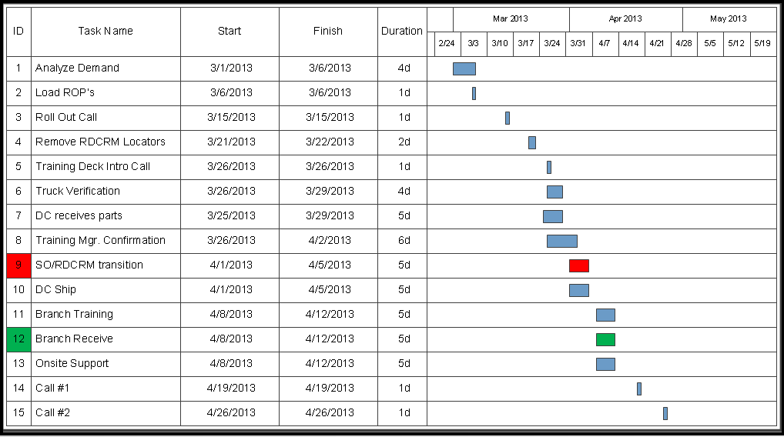

Service RDC Program Schedule
Completed

Slide 4
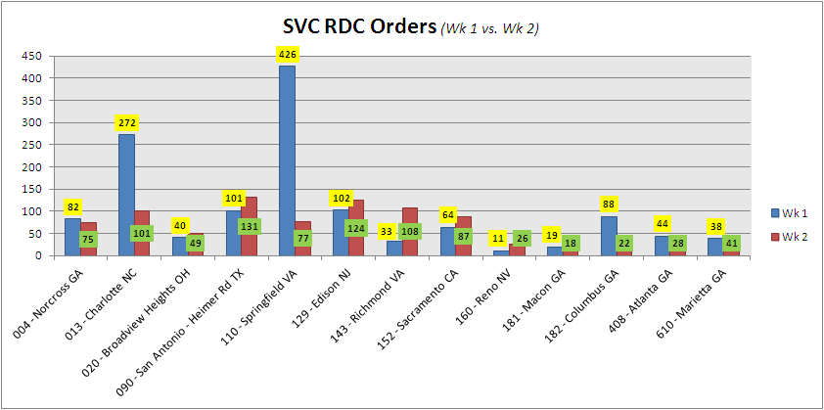
SVC Orders by Week

Slide 5
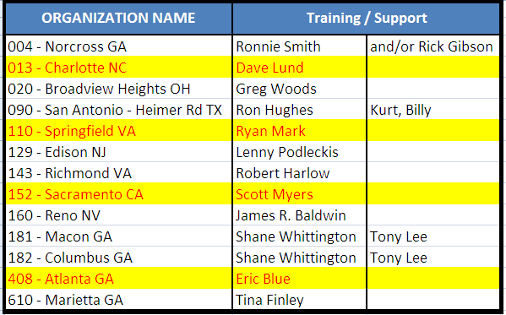
Training Review & Program Feedback
How did the training go?
Were there any challenges?

Slide 6

Questions

